Slide 1
Exact-Objective Beam Routing
QSITE 2026 — Computational Track
Routing and compiling quantum circuits onto a sparse hardware graph
Official-scorer verified · 4 of 6 benchmarks proven optimal · 67.5 vs. 283.5 baseline
Notes:
[Not part of the timed script -- a few seconds to say who you are and what this is, then move to the next slide.]
Hi -- this is our submission for the QSITE 2026 Computational Track: routing and compiling quantum circuits onto hardware that isn't fully connected. Here's what we built, and how well it scores.

Slide 2
0:00 – 0:35
The Problem
■ 20 qubits on the chip, each wired to only 1, 2, or 3 neighbors
■ A two-qubit gate can only run on a wire that actually exists
■ No wire between them? Insert SWAPs to walk the qubits together
■ Score: 1 SWAP = 1 point · 1 parallel time step = 0.5 points
■ 6 programs, one combined total — lower is better
Notes:
You are compiling a quantum program onto a chip that is not fully connected. Twenty qubits. Each one is wired to one, two, or three neighbors. A two-qubit gate can only run across a wire that actually exists.
If the two qubits are not neighbors, you insert SWAPs and walk them together. Every SWAP costs one point. Every parallel time step costs half a point. Six programs, one total. Lower wins.

Slide 3
0:35 – 1:45
What We Did — Three Ideas
■ 1. Zero-SWAP embedding — some circuits already fit the chip's shape
■ 2. Beam search on the real score — track the exact cost as we go, keep the best few paths
■ 3. Exhaustive search on small cases — proves some answers are the best possible
Notes:
Three ideas.
First: sometimes you need zero SWAPs. This chip has a path through all twenty qubits, and chain and VQE circuits sit on it. Two benchmarks finish with no SWAPs at all. The score is just half the circuit's own critical-path depth, and that is a floor on any hardware.
Second: when that embedding does not exist, we beam-search the exact score. The qubits meet along a short path, and each partial route tracks when every qubit is free, so the cost so far is the real score. We keep the best few and look ahead. Placement is lazy: a qubit gets a home the first time it is used. Locking the placement up front was worse on the dense programs.
Third: on the smaller instances, a separate exhaustive search scores routings by that same objective. When our score hits the bound, the result is optimal.

Slide 4
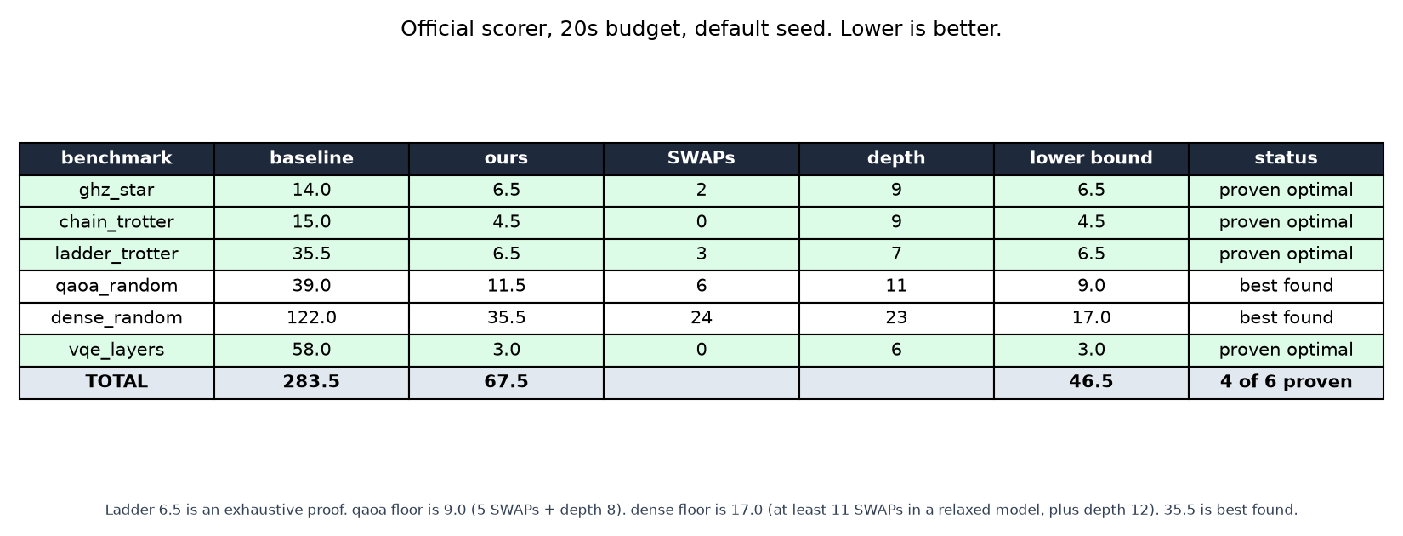
1:45 – 4:10
The Results
Notes:
[Put up scoreboard.png and leave it up for this slide.]
This table is the official scorer. Twenty-second budget, default seed. Baseline 283.5, ours 67.5, a 76 percent reduction, from the same function on every benchmark.
Four of six benchmarks, including the trickiest small one, are mathematically proven optimal, not just best-found.

Slide 5
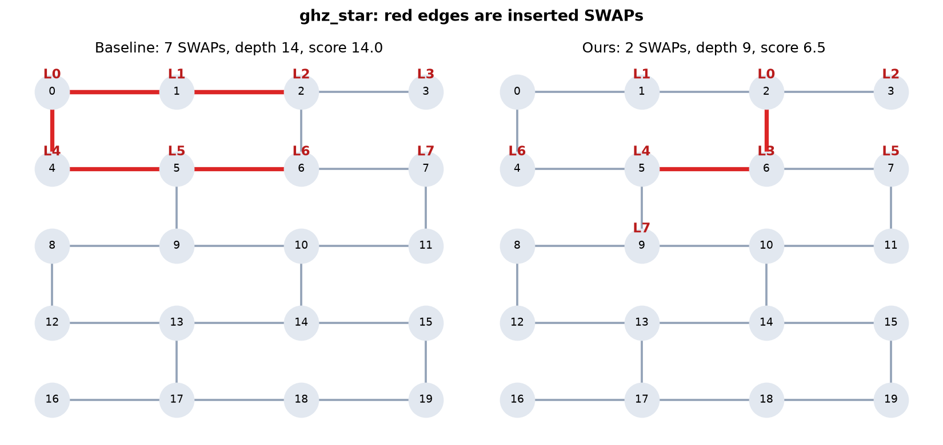
1:45 – 4:10
ghz_star — Proven Optimal
Notes:
[Switch to before_after_ghz_star.png.]
ghz_star. Baseline 14: seven SWAPs, depth 14. Ours, 6.5: two SWAPs, depth 9. Red edges are the SWAPs. The hub has seven leaves and the chip's max degree is three, so it cannot sit next to everyone. Two SWAPs is what that argument requires, and the score lands on 6.5 exactly. That is the proof.
[Optional, only if you have 10 spare seconds: play routing_ghz_star.gif here -- one frame per second, initial placement then each SWAP and gate. Skip it if you're behind on time.]

Slide 6
1:45 – 4:10
Three More, Proven Optimal
■ chain_trotter — 4.5, zero SWAPs, proven
■ vqe_layers — 3.0, zero SWAPs, proven (baseline was 58)
■ ladder_trotter — 6.5: 3 SWAPs, depth 7, proven by exhaustive search
Notes:
chain_trotter is 4.5, zero SWAPs, proven. vqe_layers is 3.0, zero SWAPs, proven. The baseline on vqe was 58.
ladder_trotter is 6.5: three SWAPs, depth 7. An exhaustive search, separate from the solver, proved no valid routing scores below 6.5. Our solution matches that bound, and the official scorer validates it.

Slide 7
1:45 – 4:10
qaoa_random — Best Found
■ Best found: 11.5 — 6 SWAPs, depth 11 (baseline was 39)
■ Proven floor: 9.0 — at least 5 SWAPs required, depth already at least 8
■ At most 2.5 points still open
Notes:
qaoa_random is best found at 11.5, against a baseline of 39 and a proven floor of 9. At least five SWAPs are required and the depth is already at least 8, so at most two and a half points remain open.

Slide 8
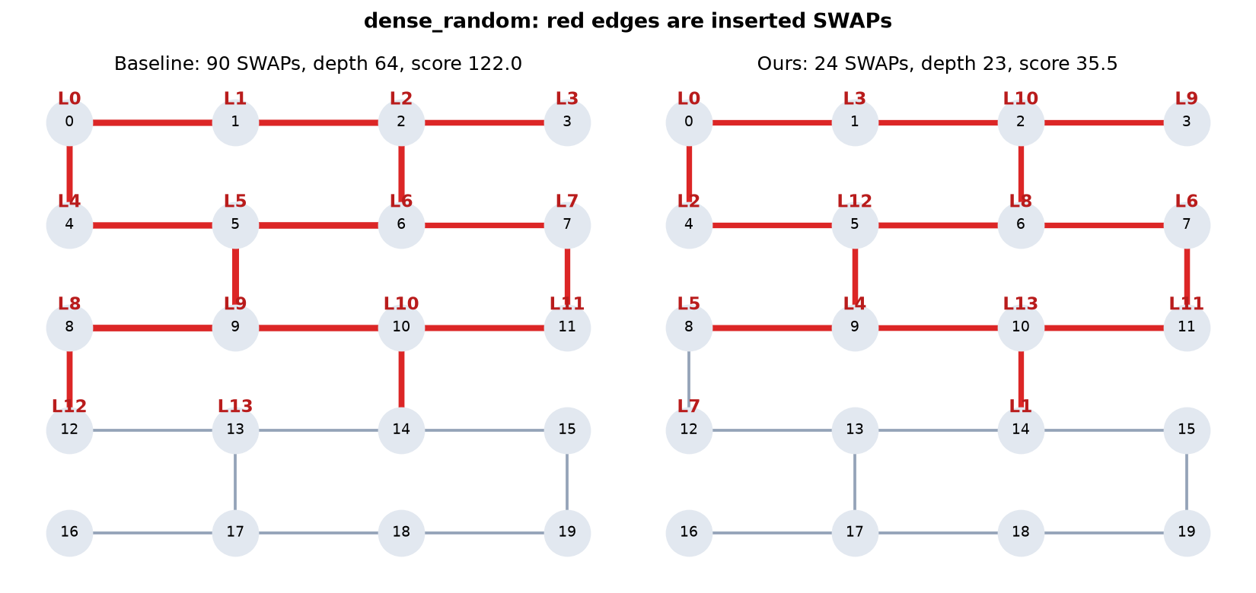
1:45 – 4:10
dense_random — Still Open
Notes:
[Switch to before_after_dense_random.png.]
dense_random is still open. Forty interactions on fourteen qubits. The baseline inserts 90 SWAPs at depth 64, score 122. We got 24 SWAPs, depth 23, score 35.5. The proven floor is 17: at least eleven SWAPs, and depth at least 12. That floor comes from a published SAT encoding of a more permissive routing model, so it is a real floor under our stricter rules. Our current search plateaus at 35.5. A 240-trial sweep, a 650-run randomized-lineage sweep, and about three thousand officially scored window splices all stop there. Whether the true minimum is close to 17 or close to 35.5 is still an open question.

Slide 9
4:10 – 4:35
Where We Landed
Notes:
[Back to scoreboard.png.]
So: 67.5 versus 283.5. Four benchmarks match a proof. qaoa is inside two and a half points of its floor. dense is still open between 17 and 35.5. Every answer is checked by the official scorer before we accept it.

Slide 10
4:10 – 4:35
Bonus: Fewer Gates, More Points
■ Rewrote every circuit into the native gate set (RZ, SX, CNOT)
■ 410 fewer gates than the provided baseline decomposer (650 → 240)
■ Organizers confirmed this bonus counts — that's 41.0 points
■ Reported total: 67.5 − 41.0 = 26.5
Notes:
One more number: the organizers confirmed our stretch-goal gate count counts too. Rewritten into native gates, our circuits use 410 fewer gates than the provided bad decomposer. That's forty-one more points, so the total we're reporting is 26.5.

Slide 11
Thank You
Happy to take questions.
Notes:
Happy to take questions.

Slide 12
Appendix — Anticipated Questions
Not part of the timed 5-minute script. Use these only if you want to pre-empt a question in your recording -- each note below is written to be read exactly as-is.
Notes:
[Divider slide -- nothing to read aloud. The next few slides are optional backup material, only needed if you choose to address likely questions directly in the recording.]

Slide 13
Q&A (OPTIONAL)
Is dense_random optimal?
No. Proven floor 17.0, our score 35.5: 24 SWAPs, depth 23, baseline 122. The floor is at least eleven SWAPs, from a published SAT encoding of a more permissive model, plus depth at least 12. It rests on that encoding. A 240-trial sweep, 650 randomized lineages, and about three thousand window splices all plateau at 35.5, so this search approach has stalled. That does not locate the true minimum. It may sit near 17, or near 35.5. We have not settled which.
Notes:
No. Proven floor 17.0, our score 35.5: 24 SWAPs, depth 23, baseline 122. The floor is at least eleven SWAPs, from a published SAT encoding of a more permissive model, plus depth at least 12. It rests on that encoding. A 240-trial sweep, 650 randomized lineages, and about three thousand window splices all plateau at 35.5, so this search approach has stalled. That does not locate the true minimum. It may sit near 17, or near 35.5. We have not settled which.

Slide 14
Q&A (OPTIONAL)
Is qaoa_random optimal?
No. Best found is 11.5: 6 SWAPs, depth 11, baseline 39. The proven floor is 9.0, because at least five SWAPs are required and the critical-path depth is 8. Headroom is at most 2.5. A search aimed at ruling out 11.0 and 10.5 timed out before it finished, so "within half a point" is not a claim we can make.
Notes:
No. Best found is 11.5: 6 SWAPs, depth 11, baseline 39. The proven floor is 9.0, because at least five SWAPs are required and the critical-path depth is 8. Headroom is at most 2.5. A search aimed at ruling out 11.0 and 10.5 timed out before it finished, so "within half a point" is not a claim we can make.

Slide 15
Q&A (OPTIONAL)
Will the grader get 67.5?
With the default seed and the 20-second budget, yes, that is what the official scorer returned on the run checked for this demo. It is an anytime search. Under a heavy machine it can stop on an earlier checkpoint. We saw qaoa_random come back 12.5 instead of 11.5 once, before we raised the budget from 10 seconds to 20. A different seed can land a point or two worse on the hard benchmarks. It will not come back invalid, and it will not go below the proven floors.
Notes:
With the default seed and the 20-second budget, yes, that is what the official scorer returned on the run checked for this demo. It is an anytime search. Under a heavy machine it can stop on an earlier checkpoint. We saw qaoa_random come back 12.5 instead of 11.5 once, before we raised the budget from 10 seconds to 20. A different seed can land a point or two worse on the hard benchmarks. It will not come back invalid, and it will not go below the proven floors.

Slide 16
Q&A (OPTIONAL)
Did you do the stretch goals — decomposition and single-qubit optimization?
Yes. decompose.py rewrites SWAP into 3 CNOTs and each program two-qubit gate into 1 CNOT, into the native RZ, SX, CNOT set; optimize_1q.py merges and cancels the single-qubit runs that produces. Checked against the deleted reference decomposer, which pads every op with RZ(0) identities -- seven gates per SWAP, three per two-qubit gate -- our circuits use 240 gates instead of 650. That's 410 gates saved, 41.0 points at the README's N times 0.1. verify_stretch.py reproduces that count and checks the decomposition against the routed program structurally.
The README still lists decompose() and optimize_1q() as optional and still says the score improves by N times 0.1, even though an earlier commit removed that bonus from the headline formula and deleted the reference implementation. We asked the organizers directly: it counts. That is where the 26.5 comes from.
Notes:
Yes. decompose.py rewrites SWAP into 3 CNOTs and each program two-qubit gate into 1 CNOT, into the native RZ, SX, CNOT set; optimize_1q.py merges and cancels the single-qubit runs that produces. Checked against the deleted reference decomposer, which pads every op with RZ(0) identities -- seven gates per SWAP, three per two-qubit gate -- our circuits use 240 gates instead of 650. That's 410 gates saved, 41.0 points at the README's N times 0.1. verify_stretch.py reproduces that count and checks the decomposition against the routed program structurally.
The README still lists decompose() and optimize_1q() as optional and still says the score improves by N times 0.1, even though an earlier commit removed that bonus from the headline formula and deleted the reference implementation. We asked the organizers directly: it counts. That is where the 26.5 comes from.

Slide 17
Q&A (OPTIONAL)
How do you know ladder_trotter is fully optimal?
An exhaustive search over placements and SWAP sequences, with the real swaps-plus-half-depth score, proved that no valid routing scores below 6.5. Our 3-SWAP, depth-7 solution matches that bound, and the official scorer validates it. The same search code was cross-checked against brute force on 65 small instances with zero disagreements. The old caveat, "three SWAPs is minimal but a shallower depth might still win," is closed.
Notes:
An exhaustive search over placements and SWAP sequences, with the real swaps-plus-half-depth score, proved that no valid routing scores below 6.5. Our 3-SWAP, depth-7 solution matches that bound, and the official scorer validates it. The same search code was cross-checked against brute force on 65 small instances with zero disagreements. The old caveat, "three SWAPs is minimal but a shallower depth might still win," is closed.

